Slide 1
End of Year QUIZ
11PDHPE IN REVIEW

Slide 2

For the following slides, fill in the missing words.

Slide 3
Muscle | Origin | Insertion | Action
Triceps |  | Ulna
Soleus | Tibia, fibula |  | Plantar flexion of foot
Trapezius |  | Scapula, clavicle | Adduction arm
Erector Spinae | Base of skull
Hamstrings |  | Tibia, head of fibula | Extension of thigh, flexion of lower leg

Slide 4
Ottawa Charter
__________ Public Policy
Creating ___________ ______________
Strengthen ____________ ___________
___________ Personal ___________
____________ health services

Slide 5
Agonist & Antagonist Muscle Pairs
 | Triceps
 | Latissmus Dorsi
Trapezius
 | Hamstrings
Tibialis Anterior

Slide 6
STOP regime
S______
T______
O______
P______

Slide 7
Name that bone
Largest and longest bone in body
Small bone in front of the knee
Large, flat, triangular bone
The inner, larger bone of the leg

Slide 8
What’s that tune?
Name the song, and the artist.

Slide 9

What?
Answer the following questions and provide examples

Slide 10
What are modifiable health determinants?

Slide 11
What are the short term effects of exercise on
the respiratory system?

Slide 12
How does balance & stability influence movement in a sporting context?

Slide 13
Justify three reasons why people take part in outdoor recreation

Slide 14
What are safety issues to consider with first aid and protective strategies you can adapt?

Slide 15
How can health promotion be used in schools?

Slide 16
What is the difference between the systemic and pulmonary circulation system?

Slide 17
Describe how environmental factors impact an individual’s health?

Slide 18
Outline the structure and function of a synovial joint. (Use knee as example)

Slide 19
What are 3 issues to consider when selecting a suitable campsite?

Slide 20

Mix ‘n’ Match
From the following pictures and items – work out their relationship to the PDHPE syllabus and discuss

Slide 21
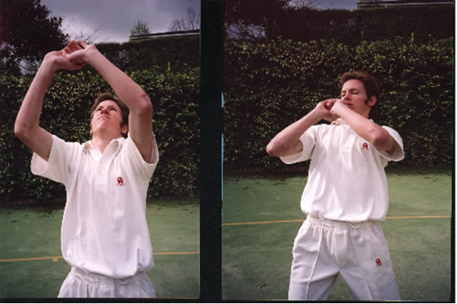

Slide 22
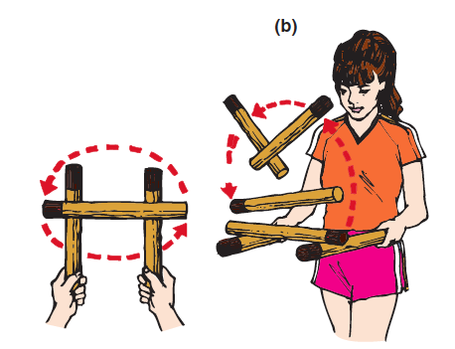

Slide 23
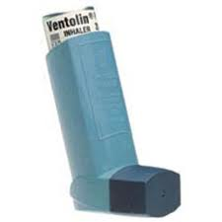

Slide 24
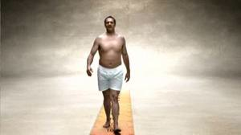

Slide 25
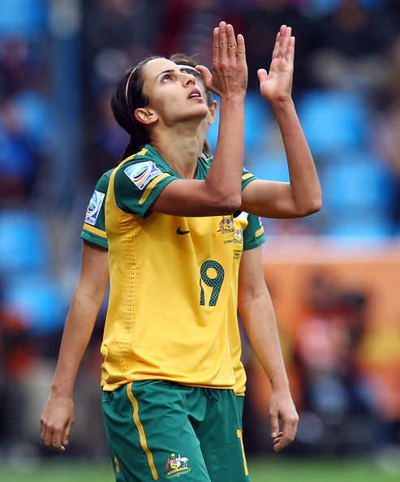
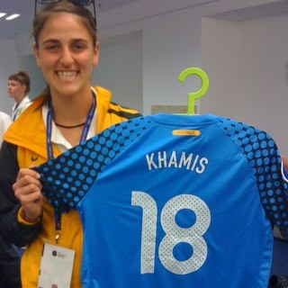
VS.

Slide 26

Mixed Bag
Answer the following questions about PDHPE and other stuff

Slide 27
How many drinks can be consumed by a female full licensed driver in the first hour, and still remain under the legal BAC limit?

Slide 28
How many compressions should be given in CPR?

Slide 29
How many passengers can a P-plater carry at 11:12pm?

Slide 30
Place the PE Faculty in order of how many years they have been at SRHS.
Ratusau, Zieba, Sultana, Dunajcik, Bordado,Rawlings, Sculley, Ng.

Slide 31
How many times higher are males aged 15-29 at risk of road accidents compared to females?

Slide 32
How many PE staff were not born in Australia?
Bonus marks: Name the teacher/s and country of birth

Slide 33
What is the minimum depth a hole should be dug if someone needs to urinate at camp?

Slide 34
Which PE teacher used to teach English at SRHS and which one is a trained English teacher but chooses teach PE?
(hint: need 2 names)

Slide 35
Which PE staff member represented their country at their chosen sport?
Bonus mark: if you can name the sport they played.

Slide 36
DRABCD stands for?

