Slide 1
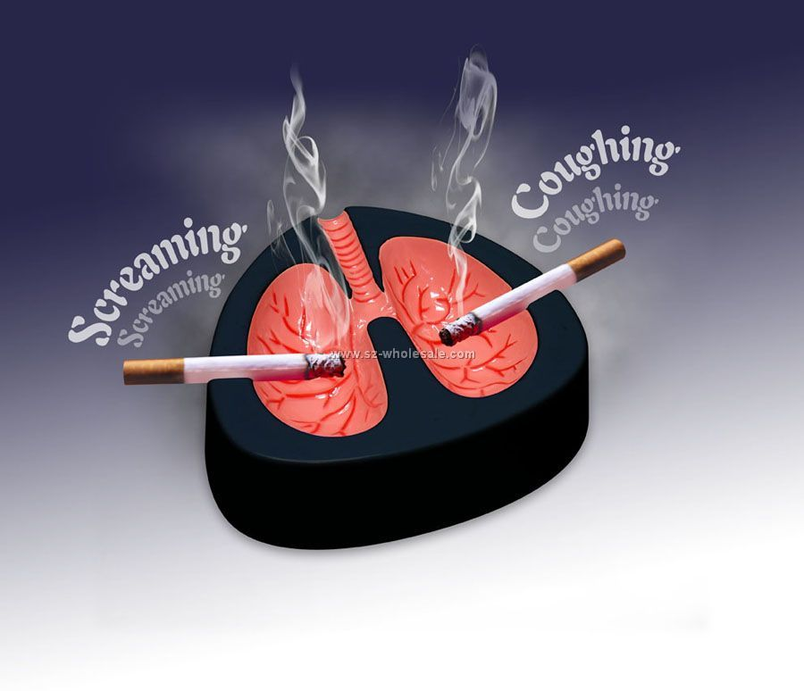
LUNG CANCER
QUIT NATIONAL TOBACCO CAMPAIGN

Slide 2
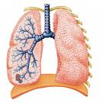
PART A
LUNG CANCER

Slide 3
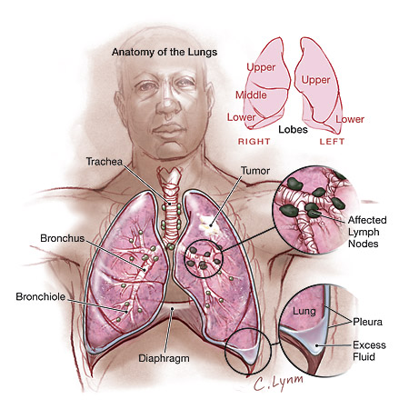
Nature of Lung Cancer
Lung Cancer is a disease of uncontrollable cell growth in the tissue of the lungs. The growth may lead to an invasion of adjacent tissue and infiltration beyond the lungs which is called metastasis.

Slide 4
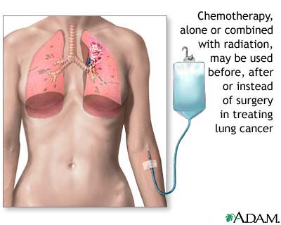
Nature of Lung Cancer
The majority of the primary lung cancers are created through the several kinds of cancerous growths deriving from forming a protective layer of surface tissue known as epithelial cells.

Slide 5
Nature of Lung Cancer
This particular type of cancer is the most common cause of cancer related deaths for males and the second most for females coming behind Breast cancer.
Lung cancer is responsible for over 1.3 million mortalities in the world, which occurs annually. Some of the most common symptoms are shortness of breath, coughing, and weight loss.

Slide 6
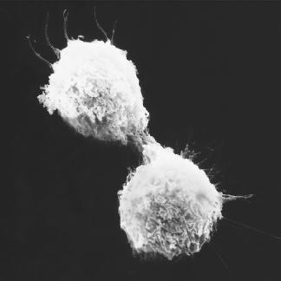
Types of Lung Cancer
There are two main types of lung cancer, the first type is small cell lung carcinoma and secondly there is non-small cell lung carcinoma. This distinction is very important as for they both need different types of attention.

Slide 7
Small Cell Lung Carcinoma
Small cell lung carcinoma which is also known as oat cell carcinoma, is less common. It tends to develop in the larger airways such as the primary and secondary bronchi; it grows rapidly increasing in size. The oat cell contains thick neurosecretory granules (vesicles containing neuroendocrine hormones), which give this an endocrine syndrome association.

Slide 8
Small Cell Lung Carcinoma
This particular type of lung carcinoma will respond much better to chemotherapy and radiation due to the much worse prognosis is metastatic at presentation. This particular type of carcinoma is affiliated with smoking tobacco.

Slide 9
Non-Small Cell Lung Carcinoma
The non-small cell lung carcinomas are grouped together because their prognosis and management are similar. There are 3 main sub types: squamous cell lung carcinoma, adeno carcinoma, and large cell lung carcinoma. 31.2% of lung cancers is because of squamous cell lung carcinoma which usually starts near a central bronchus.

Slide 10
Non-Small Cell Lung Carcinoma
Cavitations and necrosis within the center of the cancer is a common finding. Well-differentiated squamous cell lung cancers often grow more slowly than other cancer types.
Adeno carcinoma accounts for 29.4% of lung cancers. It originates in peripheral lung tissue.

Slide 11
Non-Small Cell Lung Carcinoma
Most cases of adeno carcinoma are associated with smoking; however, among people who have never smoked, adeno carcinoma is the most common form of lung cancer. A subtype of adeno carcinoma, the bronchioloalveolar carcinoma, is more common in female never-smokers, and may have different responses to treatment.

Slide 12
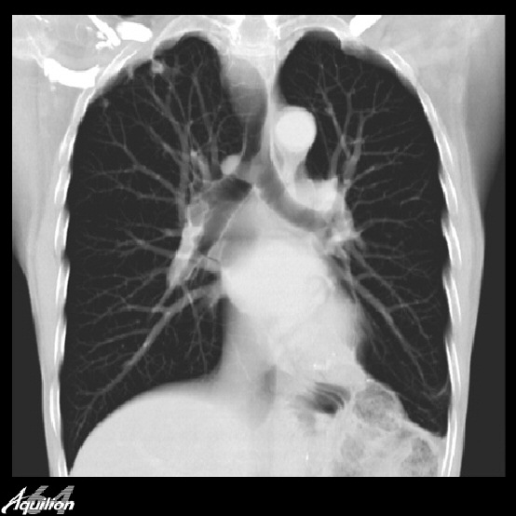
Extent of the Problem
The trends are updated from 1996-2005 but even though these are the most recent trends posted up on the cancer council website it shows that the increases and decreases are continuously occurring throughout the following years such as:
From 1996-2005 the age-standardized incidence rate of lung cancer fell by 19% in males and rose by 15% in females.

Slide 13
Extent of the Problem
The age-standardized mortality rates fell by 21% in males, but there was no significant change in mortality rates in females over the same period.
Estimated number of new cases of lung cancer is expected to increase slightly to 3,081 in 2007 and number of deaths is expected to continue to remain at 2,421.

Slide 14
Extent of the Problem
Compared with NSW as a whole between 2001 - 2005, the incidence of lung cancer was lower in males in the Northern Sydney and Central Coast Area Health Service and significantly higher in males in Sydney South-West Area Health Service.

Slide 15
Extent of the Problem
Also it shows the incidence and mortality rates of this particular disease ranging from years that are unknown up to the year 2005 just as the trends.
There were 2,950 new cases of lung cancer in NSW in 2005 (1,784 maels and 1,166 females).

Slide 16
Extent of the Problem
2,371 people died from lung cancer in NSW in 2005 (1,499 males and 872 females).
Using 2005 figures, 1 in 26 males and 1 in 41 females will develop lung cancer by the age of 75.
Lung cancer is the third most common cancer in males and the fourth in females.

Slide 17
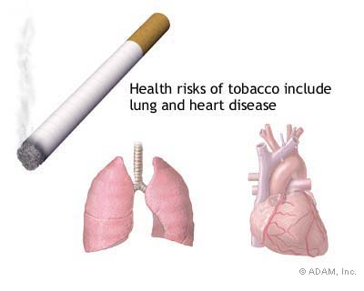
Extent of the Problem
Lung cancer is the most common cause of cancer death in males. Both breast and lung cancer ranked equally as the most common cause of cancer death for females.

Slide 18
Risk Factors
The most common risk factors for Lung Cancer is:
Growing older (the average age of new cases of cancer is 66 years, and the average age of cancer deaths is 72 years.
Smoking, alcohol use, and poor diet and inactivity leading to increased weight and obesity are the most important modifiable (avoidable) causes of cancer.

Slide 19
Risk Factors
Genetic susceptibility (most cancers are not due to an inherited susceptibility but result from genetic changes that occur during one's lifetime within the cells of a particular organ or tissue).
Radiation (including ionizing and ultraviolet radiation (including tanning beds).

Slide 20
Risk Factors
Infection (certain bacterial, parasitic and viral types).
Environmental and occupational exposures (including formaldehyde, arsenic, asbestos, dioxin, wood dust and other particulate matter in the air, and a wide range of other known and probable environmental carcinogens).

Slide 21
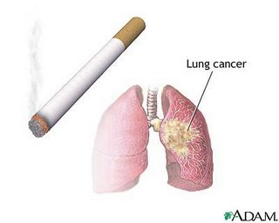
Risk Factors
By reducing the external risk factors we’re also reducing the risk of death from lung cancer, these things can be reduced by monitoring intensively on individuals at risk, detecting and treating cancers earlier while they are still developing, and treating them in accordance with the best available evidence.

Slide 22
Groups at Risk
Groups such as Smokers, and workers exposed to industrial substances such as asbestos, nickel, chromium compounds, arsenic, polycyclic hydrocarbons and chloromethyl ether have a significantly higher risk of developing lung cancer. Smoking is the leading preventable cause of death and disease in Australia. In 2003, it was estimated that tobacco use was responsible for more than 15,500 deaths or nearly 12% of all deaths.

Slide 23
Groups at Risk
Tobacco use reduces not only your life expectancy but your quality of life. Many medical conditions caused by smoking can result not just in death, but in living for years with disabling health problems. It is estimated that more than 204,700 years of healthy life were lost in Australia, in 2003, as a result of smoking.

Slide 24
Groups at Risk
While some health effects from smoking are immediate there is a long time lag, sometimes decades, between smoking and many tobacco-related diseases. This lag can result in some smokers believing it won’t happen to them. However, half of all lifetime smokers will die from smoking related diseases, and half of these will be in middle age (35-69yrs).

Slide 25
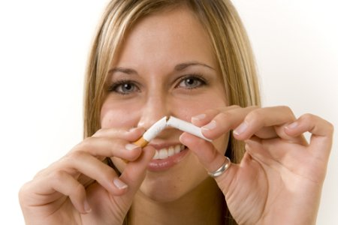
Groups at Risk
Exposure to second-hand smoke also causes premature death and disease in children and adults who do not smoke. There is no risk-free level of exposure to second-hand smoke or as we know of it as Passive Smoking.

Slide 26
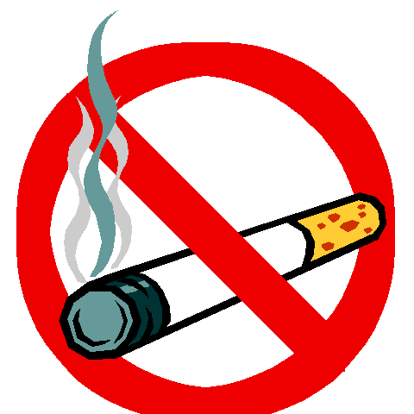
PART B
QUIT NATIONAL TOBACCO CAMPAIGN

Slide 27
Quit National Tobacco
This campaign which is apart of the Australian governments continuing work to reduce the in take amount of tobacco to reduce the harm of lung cancer caused by smoking tobacco. This is aimed at all Australians that smoke both adults and youth. This campaign is designed to provide information and other resources to help people successful quit smoking and further more provide information to the Australian government tobacco campaigns.

Slide 28
Quit National Tobacco
The campaign states that if we can make education and communication a necessity, we can be able to maintain the decline and continue to reduce the cost of tobacco to the Australian communities. This campaign has created some ways to trigger the start of people wanting to quit smoking such as graphic health warnings.

Slide 29
Improvements
Graphic health warnings on tobacco products are making an important contribution to reduce the prevalence of smoking in Australia. Graphic health warnings are now compulsive to be printed on all Australian manufactured and imported tobacco product packaging from the first of march 2006.

Slide 30
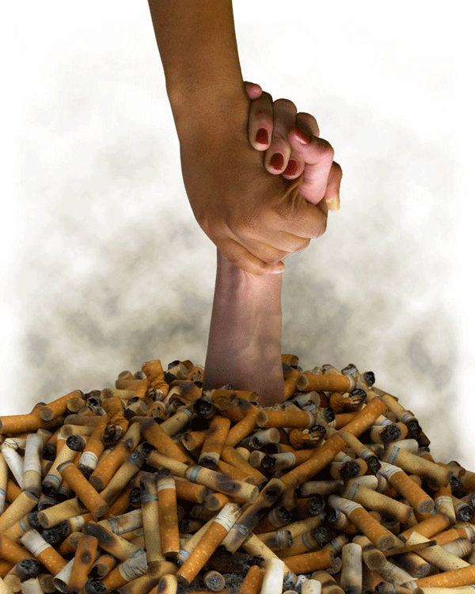
Improvements
The graphic health warnings aim to increase the knowledge of the health effects related to smoking, to encourage quitting smoking and discouraging the start of smoking.

Slide 31
Strengths
Scare tactics
Media usage
- Television
- Radio
- News papers
Advertising the effects of smoking
- Graphic pictures
- Powerful slogans
Quindex In order to summarize change in quitting intention and activity and examine subgroup differences, we developed a quitting activity index called Quindex
Quite line

Slide 32
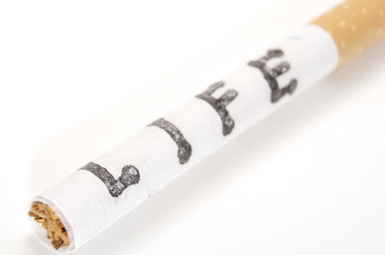
Weaknesses
Smokers ignoring the campaign
Non smokers disagreeing with the campaign also feeling that the information is exaggerated
False accusations

