Slide 1
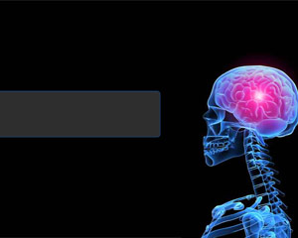
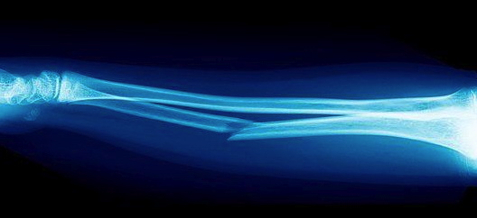
11PDHPE Preliminary Course
Option 1
First Aid

Slide 2
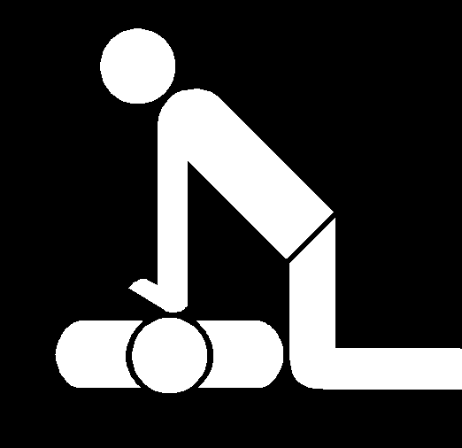
Focus Questions
What are the main priorities for assessment and management of first aid patients?
How should the major types of injuries and medical conditions be managed in first aid situations?
What does the individual need to consider in administering first aid?

Slide 3
11PDHPE Preliminary Course
Core 2: Focus Question 1
What are the main priorities for assessment and management of first aid patients?

Slide 4
Setting priorities for managing a first aid situation & assessing the casualty
Situational Analysis
For most of our lives few, if any, emergencies requiring us to use life sustaining skills ever happen. However, there is a chance that at some stage we may need to resuscitate a person whose breathing or heart function (or both) have ceased.
This may be the result of a:
car accident
serious sports injury
heart attack,
drug overdose
envenomation (bites from snakes, spiders etc).
The best you can do is be prepared.

Slide 5
Situational Analysis
You may be alerted to a potentially life-threatening situation by instances such as:
• the noise of a car crash
• a scream if a person is bitten by a venomous spider
• smoke
• an alarm
• being part of a situation where an accident or mishap occurred, such as a sporting injury or electrocution in the home.
In these situations it is essential that your life and safety are not placed at risk. You need to approach the situation and remain alert to possible environmental hazards that may have contributed to the accident or occurrence.
You must not become a victim yourself.
For example, a house or room may be filled with smoke. Entering the room without proper equipment will cause you to suffocate. You cannot administer effective first aid if you are injured in attempting to help someone else.

Slide 6

Situational Analysis
The Royal Life Saving Society Australia suggests that all first aid treatment is based on:
• commonsense and
• knowledge
and that these factors go hand-in-hand in the preservation of life. Keeping this
in mind, you should:
• check for danger
• take steps to remove or limit the danger or remove the victim from the
danger.

Slide 7
Priority assessment procedures
In emergency situations, it is important to act quickly but calmly. Urgency is critical because if the passage of air to the lungs is blocked or the heart has ceased to beat, brain function progressively shuts down.
Each second lost places the patient at further risk of brain damage and death.
Royal Life Saving Society Australia guidelines state that ‘the first person at the scene is responsible for the initial support of the casualty’, including working through the DRABCD action plan.
The second person needs to support the first person by ‘contacting emergency services, protecting and interviewing bystanders and gathering first aid equipment before helping with resuscitation’.
Should two people arrive at the same time, the most experienced should immediately attend to the casualty.

Slide 8
Priority assessment procedures
Procedures to follow during an emergency may include:
requesting a mobile phone from bystanders
contacting emergency services
directing people to go for help
instructing people on how to give two-operator cardiopulmonary resuscitation
observing people who may be in a state of shock
requesting assistance with bandaging, control of bleeding or attaching
slings and splints
When contacting emergency services, the following order of priorities needs
to be observed.
• Dial 000 and request help.
• State the type of accident (car, drowning, electrocution, etc.).
• State the number of people injured.
• Clearly identify the location by providing the house number, street and
suburb. If an accident has happened on the road, name the road and the
nearest cross-street if possible.

Slide 9
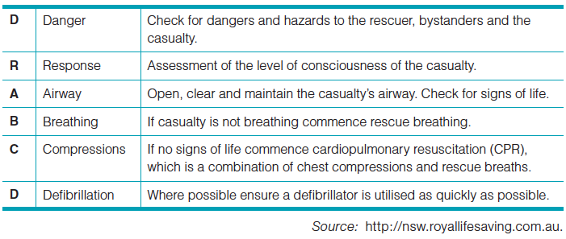
DRABCD
The DRABCD action plan is easy to remember and, when the procedures are carried out correctly, you have the best chance of sustaining life, preventing further injury and minimising risk to all.

Slide 10
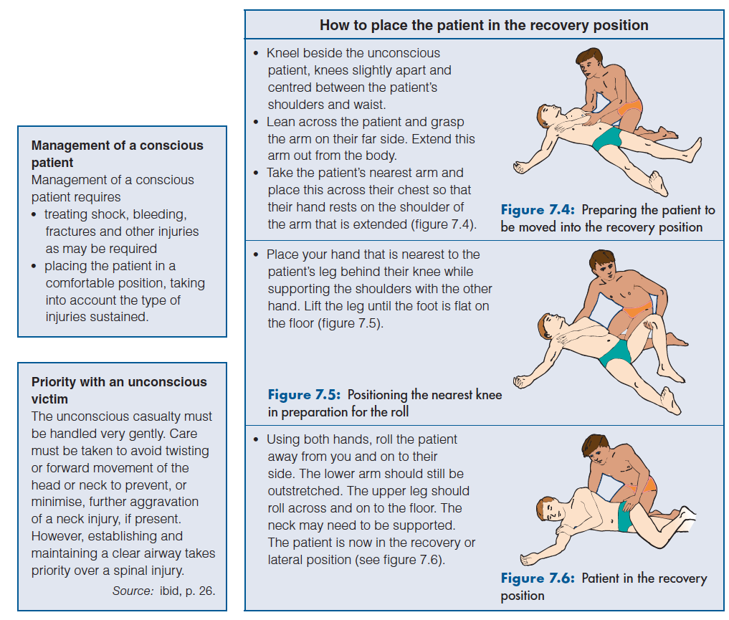
recovery POSITION

Slide 11
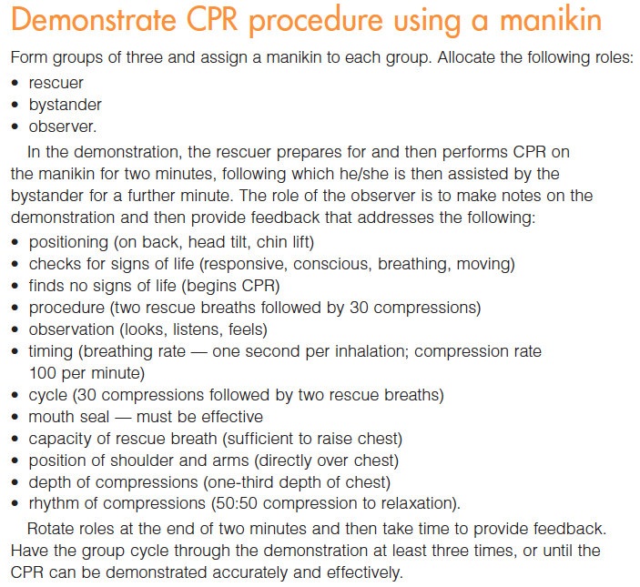
ACTIVITY: CPR

Slide 12
STOP REGIME
Using the STOP regime for evaluation of suspected injuries precedes a whole of body assessment. Use of STOP, particularly in sports situations, increases the chances of correct diagnosis of minor injuries, leading to a more accurate whole of body assessment. If there is any doubt about the risk of further injury to the injured person, consult an appropriate professional.
Stop
Talk
Observe
Prevent further injury

Slide 13
ACTIVITY: Crisis MANAGEMENT
In groups of 4, using A3 paper, students are to make posters summarising the following areas of crisis management. Textbook pages 264-267.
Allocate the following topics to groups
Bleeding
Shock
Neck & Spinal Injury
Moving casualty
Care of unconscious casualty
Summarise key points and action plans for treatment.
Present information to class and discuss treatments. Complete worksheets during presentations.
Note: Medical referral is on following slide.

Slide 14
Medical referral
The patient needs to be sent to hospital if any of the following happened:
• CPR was required
• the patient was unconscious at some stage
• conditions such as a heart attack or spinal injury were suspected.

Slide 15
ACTIVITY: minute to win it-
Crisis MANAGEMENT
Give students time to prepare using palm cards with emergency scenarios
Students should sit in small groups. Allow each group to conduct an assessment of the situation on each palm card, then plan an appropriate response.
Pass the cards around the groups until all students have addressed each scenario.
4. At the conclusion, the teacher collects the cards and shuffles them and gets minute to win it counter up on board.
Select one student from a group, to sit up the front. Select a card, read the scenario, start timer.
Selected student needs to briefly report (You have 1 minute) on their response to the situation
Award point to groups/teams for correct responses. Continue until all students have had a go
Encourage class discussion of issues and evaluate the responses.
Minute to win it timer: http://bit.ly/MYp406

Slide 16
11PDHPE Preliminary Course
Option 1: Focus Question 2
How should the major types of injuries & medical conditions be managed in first aid situations?

Slide 17
Management of injuries
Individuals can sustain a wide range of injuries. It is particularly important to be able to identify the symptoms for each type of injury and be familiar with the appropriate management techniques. Paying careful attention to the surrounding environment (such as the presence of electrical wires) and gaining an account of what happened from listening to the injured person or bystanders helps assess the type of injury and determine the management technique.
Activity: management of injuries worksheet
Using pages 267-273 from the textbook, complete the management of injuries worksheet.

Slide 18
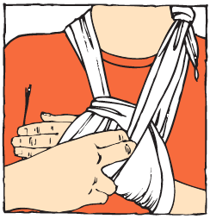
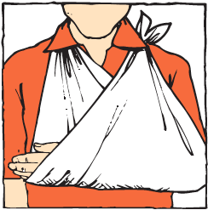
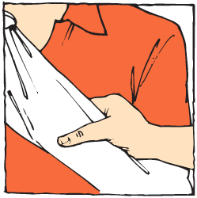
Practical activity
Applying bandages, slings & splints
Working in pairs, take turns to apply a splint, an arm sling and a pressure immobilisation bandage to your partner.

Slide 19
11PDHPE Preliminary Course
Option 1: Focus Question 3
What does the individual need to consider in administering first aid?

Slide 20
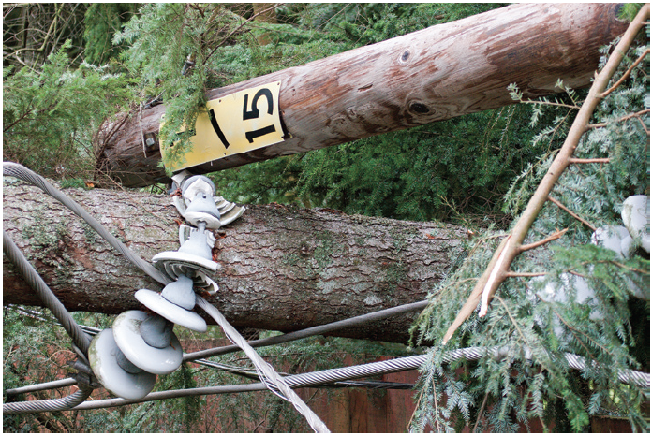
Physical environment
The nature of the physical environment may, in part, have been responsible for the occurrence of the accident in the first place. For example, a drowning may have occurred because of rapidly rising water. Whatever the circumstances, it is important that protective measures be observed and strategies put into place so that a further injury does not occur.
The following slides outline action plans for first aid scenarios in an open environment.

Slide 21
Traffic accidents
In the case of traffic accidents, the rescuer must be aware of the potential danger from:
• oncoming traffic
• fallen electricity wires
• flammable liquids such as LPG, gas and petrol
• glass and debris
• fire.
Protective strategies that the rescuer needs to observe include:
• providing a protective barrier by parking a vehicle between the oncoming
traffic and the accident
• turning hazard lights on
• placing a warning signal or sending a person back up the road to warn traffic
• turning the ignition off if the engine is still running
• lighting the area with low beam if the accident has occurred at night to
raise awareness and increase safety.
When the rescuer has followed the protective strategies, they can:
• call for or send for help
• assess the number of casualties and potential dangers. If fallen electricity
wires are in contact with the vehicle, the vehicle must not be touched as
electrocution may occur.
• implement the DRABCD procedures

Slide 22
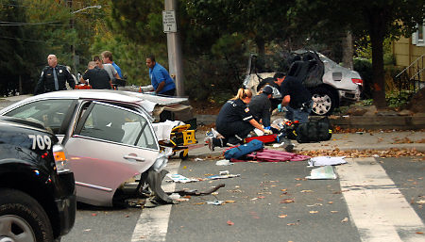
Traffic accidents
Do not remove the casualty unless one or a number of the following conditions
is present:
1. there is evidence of increasing shock and the casualty is upright in the car
2. the casualty is unconscious and an adequate airway cannot be maintained
3. the casualty’s position prevents access to control bleeding
4. there is danger of fire.

Slide 23
WATER ENVIRONMENTS
The water environment can disguise particular problems. The rescuer must be aware of:
their own physical limitations, such as:
• their ability to swim
• the desperation of a drowning person and their potential to cause difficulty to the rescuer
• hazardous objects under the water and not visible to the observer
• dangerous rips and currents
• changes in weather conditions
• water temperature.
Protective strategies that need to be used include
• sending for help immediately
• not placing yourself at risk if you are not sure that you can perform the rescue safely
• using ropes, branches and flotation devices where possible
• entering unknown waters carefully.

Slide 24
ELECTRICITY
Electricity has an immense potential for danger because it is not visible. We know it is in electrical wires. When the wires are exposed through circumstances such as frayed or cut electrical insulation or fallen power lines, electricity is conducted through any metallic material that is in contact with the wires. By touching the conducting material, such as a car body, electrocution occurs. The voltage in most wires is sufficient to cause severe burns and instant death.
The rescuer needs to:
• be aware of the deadly nature of electricity and how it is conducted
• examine the situation and assess the potential for harm.
Protective strategies include
• not touching cars or objects that are in contact with fallen power lines
• turning the power off at the source (light switch or main switch) in the case of a domestic accident
• removing live power cords with nonconducting material such as a stick if the power cannot be turned off immediately.

Slide 25
Infection control & protection
There is a risk of cross-infection (passing infection from one person to another) when administering first aid. This is particularly so when giving CPR or managing wounds. Illnesses that can be transferred include:
• colds and influenza
• HIV/AIDS
• glandular fever
• measles
• chickenpox
• mumps
• herpes
• hepatitis.
Administration of first aid requires that measures be taken to avoid transmission of infection under any circumstances. The first aider must use hygienic practices and create a barrier so that the infection cannot pass from one person to another.
The situations that cause most concern are in relation to HIV/AIDS infection and blood-borne viruses such as hepatitis B and C.

Slide 26
HIV/AIDS
The HIV virus (human immunodeficiency virus) that causes AIDS can be transmitted only through the exchange of blood and, in some cases, body fluids, from an infected to a non-infected person.
Highest concentrations of the HIV virus are in blood. To pass the virus from one person to another during first aid, both the casualty and the rescuer need to have cuts or wounds that are open and the blood of the infected person needs to mix with the blood of the non-infected person. This situation, although possible, is highly unlikely. It is important to realise that this type of infection must pass from the bloodstream of one person and into the bloodstream of another for transmission to take place. Although HIV exists in saliva, the quantity exchanged during CPR would not be sufficient for effective transmission and, in any case, the virus would be destroyed by the stomach juices.

Slide 27
HIV/AIDS
To prevent transmission, the first aider needs to implement appropriate management strategies that prevent any possibility of viral transfer. The simplest way is to assume that every casualty is infected and take the following precautions:
use disposable plastic gloves
cover sores, grazes, cuts, abrasions or incisions of any nature that exposes anyone’s blood
cover the face of an unconscious person with a face • mask before administering CPR
wash hands and any surfaces of the body that have made contact with the casualty with soap and warm water as soon as possible following treatment.

Slide 28
ACTIVITY: SAFETY FIRST
Research the following illnesses, describe illness and devise a safety action plan for treating casualties to prevent cross-infection.
Illness | Short description of illness & risk factors | Safety plan for treatment
Hepatitis B & C
Glandular Fever
Measles

Slide 29
Legal & Moral obligations
The legal implications of providing emergency care are often a cause of concern for many people. According to the Royal Life Saving Society Australia (RLSSA) (op. cit., p. 11), a first aider could be expected to:
• use reasonable care in assessing the priorities of the situation based on their
level of training
• take steps to call for further medical assistance
• keep the casualty stabilised until medical assistance arrives
• follow established treatment and management protocols
• not misrepresent themselves or take unnecessary risks.
The RLSSA further suggests that each individual needs to use commonsense and act in accordance with their level of training should situations requiring first aid arise.
Even though you may be saving someone’s life, as a first aider you could be sued in court or questioned over your duty of care to a patient.

Slide 30
Moral Responsibility
In emergency situations there exists a certain moral responsibility to act in accordance with your training and provide assistance to the injured or distressed. It would be considered a responsible action to help people involved in an accident. It would be irresponsible not to help people unable to help themselves. Fortunately we are not frequently tested with these situations to see just how we would respond. In many cases, the emergency first aid required is for a family member and we react instinctively. But what would we do if we came across a road accident where none of the victims were known to us?
Responsible citizenship suggests that we should help and provide assistance to the best of our ability.

Slide 31
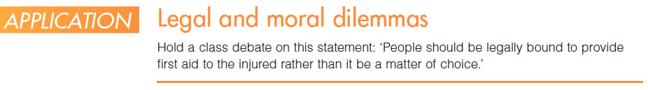
Common sense vs heroics
Basic first aid training reinforces the principles of commonsense and the prevention of further injury. The first principle of the DRABCD action plan is to remove the danger from the patient or the patient from the danger so that there is no further injury and possible loss of life. There may be some risk involved, but a rescue action does not call for heroics. Using commonsense is absolutely essential in rescues and requires that the rescuer is able to think clearly, plan thoughtfully and act wisely.

Slide 32
SUPPORT FOLLOWING FIRST AID SITUATIONS
Debriefing
Debriefing involves obtaining information about the circumstances of the incident that resulted in first aid being administered. The rescuer or rescuers may be required to give an account of what happened and describe as precisely as possible the nature of the incident. Police officers, ambulance officers or accident investigation personnel may make these inquiries.
During debriefing, it is important to:
• take the time to ensure that the full picture is gathered
• make all descriptions as accurate as possible
• remain impartial and describe the incident exactly as it occurred.

Slide 33
counselling
Rescuers involved in emergency procedures where there were fatalities and serious injuries (for example, spinal injuries or amputations) may need counselling.
Providing emergency care, organising help and possibly watching life slip away can be very upsetting for individuals and result in personal pain. This can lead to anxiety, depression and possibly an inability to cope. Where this is evident, individuals should seek or be advised to seek help. Help is available from various counselling organisations including hospitals, medical support centres and State government organisations such as NSW Health.
Counselling is beneficial as it provides the opportunity to ‘work through’ situations and dispel feelings of blame and inadequacy. Emergency first aid may provide an opportunity for a life or lives to be saved. However, if life is lost, rescuers should not feel that the blame rests with them if they acted in accordance with their training and ability level.

