Slide 1
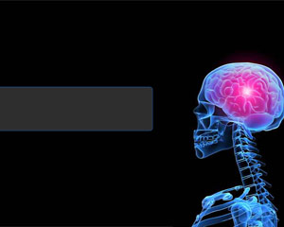
11PDHPE Preliminary Course
Core 1
Better Heath for Individuals

Slide 2
Focus Questions
What does health mean to individuals?
What influences the health of individuals?
What strategies help to promote the health of individuals?

Slide 3
11PDHPE Preliminary Course
Core 1- Focus Question 1
What does health mean to individuals?

Slide 4
Definitions of Health
The concept of health means different things to different people.
Early meanings of ‘health’
Prior to World War II, health was viewed as the opposite to illness. If there was no evidence of disease or physical illness, we were considered healthy. Any breakdown in the body system meant it was not healthy – this view suggested if you were ill – medicine, drugs and doctors could return you to a healthy state.
This early definition was recognised as too narrow and one dimensional. It failed to take into an individuals mental, social or spiritual well being and was very limited. For example, a person may not be suffering a physical illness, but may be experiencing depression or emotional stress.

Slide 5
Definitions of Health
World Health Organisation’s (WHO) definition of ‘health’
In 1946, the World Health Organisation (WHO) developed a definition of health that is still accepted today.
Health is “a state of complete physical, mental and social well-being and not merely the absence of disease or infirmity” –WHO (1946)
This definition gave greater recognition to a more holistic concept of health by recognising the whole person and focusing on more than the physical aspect of health and the absence of disease or illness.
However, the definition has its limitations…

Slide 6
Definitions of Health
LIMITATIONS TO WHO’s Definition of Health
In pairs, find one limitation of the definition of health devised by the World Health Organisation, make sure you have an example to prove your point.
You have 3 minutes before we discuss this as a class…GO!

Slide 7
DIMENSIONS OF Health
A number of dimensions all play an important role inn determining a person’s state of health. We understand a person’s level of health is the result of an interaction and balance between all four dimensions.
Physical health is the wellness of the body and the absence of chronic pain or discomfort.
Social health is our ability to interact with other people in an interdependent and cooperative way.
Mental or emotional health is a state of well-being where we can realise our abilities, cope with normal stresses of life, work productively and make a contribution to the community.
Spiritual health relates to a sense of purpose and meaning in our life, and to feeling connected with others and society.

Slide 8
Relative and Dynamic nature of Health
Health is a result of a continually changing process. From a personal perspective is may be represented on a continuum
Poor Health Optimum Health
Poor Wellbeing Positive Wellbeing
Judging where we are along the health continuum at any time is highly subjective – as people see health in different ways, have different perceptions about what is optimal or ‘normal’ and define the extremes of the continuum differently. Futhermore, when assessing their level of health people consider their past and current circumstances, as well as comparing themselves to others. For example, if we compare our physical health to that of an Olympic athlete, we may not believe ourselves to be totally healthy.

Slide 9
Relative and Dynamic nature of Health
The subjective judgments that people make about their level of health demonstrate the relative nature of health, with our health being relative to others and ourselves over time.
Relative nature of health refers to how we judge our health compared to other people or other points of time in our life.
For example:
Someone with breast cancer who has a breast removed in a mastectomy may consider her health poor compared to how it was previously or compared to other without cancer. However, she may consider her health good during her recovery compared to how it was while she was undergoing treatment.

Slide 10
Relative and Dynamic nature of Health
Health is relative to our own circumstances and that of others, and our level of health is never static. Our health varies over time. Illnesses, accidents, personal experiences or environmental factors can impact our level of health any number of times during our lives from very well to well, off-colour to ill, very unwell to critically ill and then back to full health. These continual changes in our state of health mean that health is dynamic
Dynamic nature of health refers to the constant fluctuations that occur in our level of health.

Slide 11
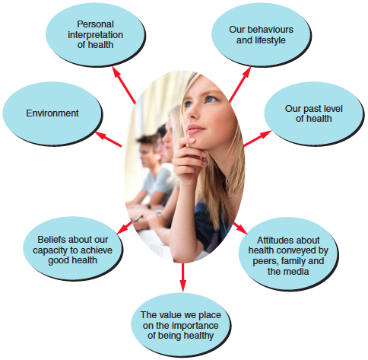
Perceptions OF Health
People’s perception of health is highly subjective. These different perceptions impact the priority we place on health and the type of actions taken. For example, exercise and sport may be more important to some compared to others.
When making judgments about our level of health and wellbeing our perceptions are influenced by a range of factors, including:

Slide 12
Implications of different Perceptions OF Health
Implications at an individual level
On an individual level, people’s perceptions of their health have a significant influence on their lifestyle choices and behaviours relating to health. For example, a person who regularly drinks large amounts of alcohol and recognises that this behaviour has a detrimental effect on their health is more likely to stop drinking, limit their alcohol intake or seek professional help compared to someone who does not believe their alcohol consumption is causing them harm.
On the other hand, an incorrect or distorted assessment of our health status-such as perceiving ourselves to be overweight when our weight fits within a healthy range, could lead to harmful health behaviours.
Differing perceptions of health may also have the potential to reinforce stereotypes. For example, a belief of being skinny or well tanned is healthy may encourage negative health behaviours such as skipping meals, excessive dieting or sun baking.
Activity – Inquiry (Page 16)

Slide 13
Implications of different Perceptions OF Health
Implications at policy level
The perception of the health status of Australians held by various levels of government, health professionals and non-government organisations drives government health policies and expenditure. Statistics of ill health are gathered to measure the health of individuals, communities and nations.
These statistics show rates of mortality, morbidity, life expectancy and years of life lost to premature mortality and causes of hosiptalisation.
Mortality is the number of deaths in a given population from a particular cause and/or over a period of time
Morbidity is the incidence or level of illness or sickness in a given population.
Life expectancy is the average number of years of life remaining to a person at a particular age, based on current death rates.

Slide 14
Implications of different Perceptions OF Health
Analysis of these trends, known as epidemiology, influences health promotion and health care within Australia. It is used to identify areas of need, determine risk factors, target prevention strategies or intervention strategies towards particular populations. Determining these health priorities impacts significantly on the allocation of expenditure and the provision of resources by all levels of government.
Conflicting perceptions can result in insufficient funding, inadequate or inappropriate support being provided to meet specific needs. Insufficient allocation of funding can also limit the number and range of strategies that can be implemented to address various health issues.
FACT: Australia’s health expenditure has increased from $72.2 billion in 1990-91 to $121.4 billion
- this indicates that health as a whole has become more of a priority for the government.

Slide 15
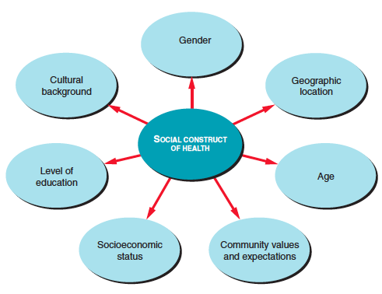
Perceptions OF Health as social constructs
Our views of good health and who possesses it are largely influenced by social, economic and cultural conditions of our family and society we live. This is referred to as our social construct.
Social construct is a concept that recognises that people have different views based on their social circumstances and ways of seeing, interpreting, interrelating and interacting with their environment

Slide 16
Impact of media, peers and family
MEDIA | PEERS | FAMILY

Slide 17
Health behaviours of young people
Young people are identified as 12-24 years of age
According to the Australian Institute of Health and Welfare (AIHW) most recent report ‘Young Australians: their health and well-being 2007’ the health of young people has continued to improve.
Evidence can be found in improvements in life expectancy rates, decline in mortality as a result of a reduction in death caused by injury, suicide and transport accidents. Reductions in morbidity from chronic diseases such as asthma, communicable diseases such as rubella, mumps and meningococcal, suicide, motor vehicles and other injuries such as poisoning.

Slide 18
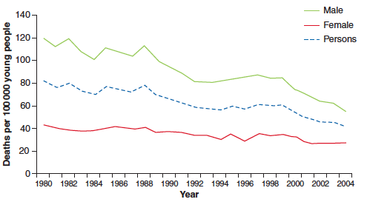
Health behaviours of young people

Slide 19
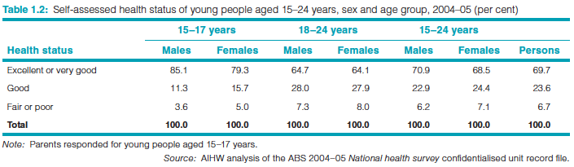
Health behaviours of young people
The improved health status of young people was supported by their own positive self assessments.
70% of Australians aged 15-24 years rated their own health as being either excellent or very good.
However, not all young people experience the same level of health

Slide 20
Health behaviours of young people
Indigenous | Remote & Rural | Low socioeconomic
Poorer levels of health & negative perception Death rate 4 times higher than non-Indigenous Lower life expectancy, live 20 years less than general population More likely to experience chronic illnesses that reduce quality of life Suffer higher rates of asthma, diabetes & injury resulting in hospitalisation More likely to experience risk factors associated with poor health such as obesity, tobacco use, physical inactivity, incarceration and lower levels of education. | Higher death rates and more hospital admissions for particular problems such as injuries and poisoning. More likely to engage in risky health behaviours such as high-risk drinking and poor dietary habits | More likely to experience poor levels of health compared to tohers Death rates are twice as high as less disadvantaged areas Higher injury rate

Slide 21
Health behaviours of young people
The report also highlighted specific health conditions that raised concern.
Mental Health Disorders are a group of mental illnesses where a person experiences disturbances of mood or thought that lead to difficulties functioning normally. These disorders include depression, anxiety disorders and schizophrenia.
The number of people who reported experiencing high levels of distress is increasing
Depression, anxiety and substance abuse accounted for 75% of the burden of disease.

Slide 22
Health behaviours of young people
Injuries
Particularly sustained from motor vehicle accidents and intentional self-harm. Leading cause of ill-health, hospitalisation and death in this age group
Injuries responsible for ⅔ of premature deaths by young people – males 3 times higher in years of life lost than females
Increasing prevalence of a number of chronic health problems and rising incidence of certain communicable diseases such as diabetes, Crohn’s disease, cerebral palsy, meningitis, chlamydia and hepatitis C

Slide 23

Protective behaviours and risk behaviours
Protective behaviours are those behaviours that are likely to enhance a person’s level of health. For example, eating the right amount of fruit and vegetables
Risk behaviours are those health behaviours that have been found to contribute to the development of health problems or poorer levels of health. For example, smoking.
Mini-powerpoint presentations ☺

Slide 24
The effect of multiple protective or risk behaviours
Research has shown that certain health behaviours are often associated to each other and that these behaviours increase health risks that young people face. For example, the National survey of Australian secondary students and sexual health 2002 found ¼ of all young people surveyed were drunk or affected by illegal drugs the last time they were sexually active. Similarly, those who experienced higher levels of stress had higher rates of drug use, in particular cigarette smoking, alcohol use and cannabis use.
In comparison, combined interaction of health protective behaviours can contribute to reducing the health risks experienced by young people. Strong family cohesion has been linked with numerous other positive health behaviours. For example, positive health behaviours associated with a family that regularly eats meals together include strong sense of family connection, higher intake of lean meat, fruit, vegetables and dairy foods, decreased consumption of high-fat and high-sugar foods, lower incidence of eating disorders, and a reduced likelihood of drug use.
Findings suggest that the more health protective behaviours present in a young person’s life, the greater the benefit to overall benefit of health.

Slide 25
11PDHPE Preliminary Course
Core 1- Focus Question 2
What influences the health of individuals?

Slide 26
The determinants of health
It is now widely accepted that a person’s health is determined by more than just biology and the lifestyle choices that each person makes. A broad range of factors relating to community, environment and social context in which people live, along with health behaviours that individuals adopt, referred to as determinants of health.
Health Determinants are the individual, socioeconomic, sociocultural and environmental factors that can have a positive or negative influence on the health of individuals or populations (The National health performance framework)
The key determinants
Individual factors: knowledge, skills, attitudes, genetics
Sociocultural factors: family, peers, media, religion, culture
Socioeconomic factors: employment, education, income
Environmental factors: geographic location, access to health services and technology

Slide 27
Individual Factors – Knowledge & skills
Knowledge and understanding that we develop about protective and risk health behaviours, products, services and support influence our ability to achieve good health. When we compare the health levels of highly educated people to that of poorly educated people in Australia, poorly educated people are more likely to have chronic illness and perceive their health as fair or poor.
Our knowledge comes from a variety of sources – parents, siblings, peers, teachers, internet, media all play a part. However, having knowledge does not mean that people are able or willing to make healthy choices.
The acquisition of skills related to decision making, problem solving, communicating, interacting and moving may contribute to improved health as having these skills will empower people to make healthier choices. For example, being able to negotiate and resolve conflict helps maintain relationships and social health.
Health literacy is the ability to understand and interpret health information and use it to promote and maintain good health.
INQUIRY pg 54 : Read Snapshot and complete questions.

Slide 28
Individual Factors – ATTITUDE & GENETICS
There is a strong link between a person’s level of knowledge and their attitude. With their attitude likely affect the way they behave. For example, those who understand the pitfalls & illnesses associated with marijuana, are more likely to be against it’s use and other forms of drug use.
Our attitudes are influenced by our family, peers, education, media, culture and communities we live in.
Our sense of self-efficacy also influences our attitudes and changes we may make to improve our health.
People’s attitude towards certain health behaviours, their willingness to seek help to address health concerns and the value they place on positive health all play a part in determining someone’s health.
Examine how our attitudes to mental health has changed.

Slide 29
Individual Factors – ATTITUDE & GENETICS
Genetics outline our potential to achieve a certain level of health. A number of genetic disorders, such as cystic fibrosis, lead to chronic ill health and decreased life expectancy. Other disorders such as down syndrome, which can affect physical development and intellectual functioning, are the result of chromosome abnormalities that occur during pregnancy.
Genetics also play a role in determining a person’s predisposition to certain diseases or health problems. People with fair skin, a genetic trait, are at greater risk of developing skin cancer. Research has identified that diseases such as breast cancer, asthma, heart disease and diabetes have a genetic link, making those with a family history of these diseases more susceptible to developing the diseases themselves.
Genetic information can also positively impact our health. Genes provide us with the potential in terms of intellectual capacity, physical abilities and life expectancy. For example, hereditary factors effect how fast we run, how coordinated we are and how well suited we are for particular sports. Therefore, have an influence on our sporting abilities and likelihood of successful participation.
However, although genetics determine our health potential, there is no certainty that we will develop all the health conditions of our family. Lifestyle, environment and other sociocultural factors influence our potential to achieve optimal health.

Slide 30
Sociocultural Factors
Sociocultural factors relate to the society in which people live and the cultural practices and expectations that exist within these communities.
Family
The family unit has a significant influence on health and well-being. Foremost, families are responsible for physical needs such as safe housing, food, clothing and medical requirements while also providing medical support such as love and care. Research shows that a cohesive family unit acts to protect the health of children and helps them coe better when they experience stressors in life (Young Australians: Their health & well-being 2007). Adversely, children living in situations of violence, abuse or neglect are at risk of immediate physical injury and emotional distress and are likely to suffer adverse consequences of long-term physical, emotional and social well-being.
Families also play a role in promoting good health, encouraging good health behaviour (eg. How much food is served and eaten/ 3 daily meals with a variety of foods), family expectations (ie. children who grow up with parents that smoke are more likely to smoke), families are also the main source of health information and support (familiy GP).

Slide 31
Sociocultural Factors
Peers
Peers have a powerful influence on the decisions people make relating to health and the type of behaviours they undertake. Young people can be particularly influenced by the values, attitudes and behavior of their peers as they seek to establish their identity and feel a sense of belonging. For example, being a part of a peer group that enjoys being active, supports the participation of people regardless of their ability will encourage peers to join in recreational activities. They can also have a detrimental effect, if their values are not supportive or differ from those held by an individual. For example, maintaining the decision not to drink alcohol when you attend a party where everyone else is drinking and questioning why you don’t drink.

Slide 32
Sociocultural Factors
Peers
Peers have a powerful influence on the decisions people make relating to health and the type of behaviours they undertake. Young people can be particularly influenced by the values, attitudes and behavior of their peers as they seek to establish their identity and feel a sense of belonging. For example, being a part of a peer group that enjoys being active, supports the participation of people regardless of their ability will encourage peers to join in recreational activities. They can also have a detrimental effect, if their values are not supportive or differ from those held by an individual. For example, maintaining the decision not to drink alcohol when you attend a party where everyone else is drinking and questioning why you don’t drink.

Slide 33
Sociocultural Factors
Media
Media has a powerful influence through it’s significant role is disseminating information relating to health. For example, advertisements about skin cancer domestic violence seek to raise awareness and enhance people’s understanding of health-related issues. It is crucial that any health-related information presented by the media is accurate, fair and balanced, as bias or inaccuracies can lead to misconceptions and confusion that can endanger someone’s health.
Media can also have an influence on:
Values and attitudes – research has shown that media images glamourising drug use, can increase the likelihood of drug use by young people. For example, images that associate smoking with positive personal qualities like popularity, masculinity and being cool contributes to a positive perception of smoking. The frequency of which smoking is shown, contributes to the belief it is common, acceptable behaviour. However, this is contrary to the National Household Survey that showed 80% of Australians were not regular smokers.

Slide 34

Sociocultural Factors
Media
Expectations of societal forms – Images conveyed through media promote certain expectations and risk behaviours that arise from these expectations. For example, the constant portrayal of images of women being tanned, attractive and slim and men are tall, tanned and muscular can contribute to beliefs about ideal body types. Pressure to conform to these stereotypes can have a considerable influence on people’s self image, their feelings about their appearance and the health behaviours they adopt in an effort to match these expectations.
Health Promotion – media can shift society’s attitudes about particular health behaviours. Health promotion campaigns on television such as those about drink driving, are frequently used to not only raise awareness but also to challenge people’s beliefs about what is acceptable behaviour in an effort to improve health.

Slide 35
Socioeconomic Factors
Socioeconomic factors: relate to a person’s level of income, education and employment.
In 2004, WHO stated that ‘the social conditions in which people live powerfully influence their chances to be healthy. Indeed factors such as poverty, social exclusion and discrimination, poor housing, unhealthy early childhood conditions and low occupational status are important determinants of most diseases, deaths and health inequalities between and within countries’.
A person’s socioeconomic status has a significant influence on the likelihood that they will be exposed to health risk factors.
Those who are disadvantaged are more likely to face the greatest number of risks and therefore find it more difficult to experience good health.

Slide 36
Socioeconomic Factors
Education
A person’s level of education has a significant impact on their health
Education enables people to have a greater knowledge of health issues and increase their understanding of health protective and risk factors
Enables people to develop skills that assist them in assisting health information and services when required
Education serves to develop within an individual a sense of empowerment over their lives.
Engagement in education influences a person’s health as having a high level of literacy and numeracy enhances opportunities for employment, post-schooling opportunities, sense of connectedness and access to support.
Low levels of education, along with significant health problems such as mental and substance issues are commonly found in people who are imprisoned, highlighting the role that attaining an adequate level of education can play in supporting health.

Slide 37
Socioeconomic Factors
Employment
Being able to secure satisfying, meaningful and regular employment has a positive influence on health.
Reports indicate that unemployed Australians have mortality rates that are 50% higher than employed Australians.
Employment provides opportunities to be active, socially engaged, interaction and a degree of financial security.
Unemployment has been linked to limited social contact, depression, loss of confidence and disempowerment.
Rates of suicide and attempted suicide are higher for those who are long-term unemployed
The type of occupation can impact health. Jobs that include heavy labour and high levels of risk taking can lead to increased chances of injury and ill-health.

Slide 38
Socioeconomic Factors
Income
Those who have higher incomes have more money available to spend on health-related products and services, such as recreational activities, private health care and better quality food.
They have the freedom to choose from a greater range of options, which would decrease stress and contribute to a greater sense of control over their lives.
Poverty, increases and individual’s exposure to risk behaviours and is likely to harm their health while also restricting their access to health services and products
Those who experience financial hardship tend to live in overcrowded conditions in communities with a high population density, fewer transport options, less recreational facilities and less support services.
Low income groups experience restrictions in their opportunity to seek help with health problems.

Slide 39

Socioeconomic Factors
Medicare is Australia’s government-funded health scheme that subsides the cost of medical services for all Australians and aims to ensure medical care is affordable
Positives
Available to everybody – makes health care more accessible
Covers minimal procedures and GP visits
Negatives
Not all services covered by Medicare (ie. non-essential services)
Long waiting lists for procedures
Waiting for treatment can lead to ongoing pain, reduced capacity to go about daily life, increased stress, physical discomfort and restrictions on social life.

Slide 40
ENVIRONMENTAL Factors
Environmental factors are those things present in the environment in which people live and work that can affect their health in a positive or negative way
Clean air, a regular supply of safe drinking water, consumption of properly handled foods can all promote improved individual and public health, while well-designed communities can assist in creating safe & harmonious communities.
Poor building design, increasing levels of pollution, changes in climatic conditions all contribute to poor health by increasing risk factors and making it difficult to choose healthier options.
Access to quality health services and reliable technology influence a person’s level of health by making it easier to obtain accurate information about health issues and seek treatment & support when necessary.

Slide 41

ENVIRONMENTAL Factors
Geographic location
Those living in rural or remote areas experience poorer health outcomes due to having higher death rates and higher levels of health risk factors including smoking, being physically inactive, drinking alcohol excessively and being overweight or obese.
Reasons for inequities experienced are complex but are linked to determinants of health such as socioeconomic and sociocultural factors.
The Distance Factor
People living in rural and remote areas have to travel long distances for work, household related issues and socialising. This places them at greater risk of injury due to the dangers involved in travelling long distances, poor road quality, factors such as speed and fatigue and animals on the road. The remoteness of communities makes maintaining social networks harder. A sense of isolation and difficulty finding emotional support due to geographic isolation may contribute to poor mental health and depression.

Slide 42
ENVIRONMENTAL Factors
The Climate & Lifestyle Factor
They are more likely to face harsh living and working conditions, as well as severe climatic conditions such as extreme heat, drought and floods that can impact negatively on both physical and emotional health. Injury, disease, emotional distress and financial hardship can result from these adverse climate conditions.
Indigenous Australian factor
24% of people living in remote areas and 45% of people living in very remote are identify as Indigenous. Aboriginal people who live in remote areas increase their exposure to health risk factors. In particular, provision of safe housing with electricity, clean running water and adequate sewerage systems are all problematic in remote areas, as a result disease outbreak from contaminated water is a real health risk, particularly for babies and young children.

Slide 43
ENVIRONMENTAL Factors
Big City Life
High levels of air pollution and poor air quality from the emissions of vehicles and heavy industry increases the risk of respiratory infections, asthma, bronchitis and cardiovascular conditions.
Traffic congestion can contribute to higher levels of stress and increases the likelihood of road crashes. Longer traveling times decreases time to be physically active and spend time with family.
People in cities are more likely to be supplied with fluoridated tap water which has a positive impact on oral health with the maintenance of healthy teeth and gums.
Built environment refers to buildings and spaces that are constructed within communities, this includes houses, shopping centres, public buildings, roads, railways, footpaths and recreational parks.
Good planning can have a positive effect on health. Construction of cycleways, footpaths, adequate lighting, playgrounds, parks and recreational facilities encourages physical activity.
Inadequate or ill-planning, can harm or expose people to risks, for example, the small size of newly released house blocks can contribute to child obesity due to the relative small size of backyards that allow for little or no play
High demand on health services can result in insufficient hospital beds and longer waiting lists particularly for non-essential surgery like knee replacements

Slide 44
ENVIRONMENTAL Factors
Access to technology
Increases to the availability and variety of technology has impacted on people’s health particularly that of young people. The regular use of technology often comes at the expense of physical activity. Prolonged periods of sedentary behaviour is associated with the increased risk of being overweight and obesity.
Technology in rural & remote areas
Advances in technology helped address some issues with living in rural and remote areas. Increased use of computers and internet has provided people in these areas with greater access to accurate health information that supports improvements in knowledge and awareness.
Assists medical professionals keep up to date with the latest research and medical advances, without leaving their practices.
Webcam and videoconferencing allows doctors to consult with health care providers, reducing time and travel needed to access health services.
Scanners and digital imaging technology can be used to send medical images for interpretation instead of patient needing to travel to the city for diagnosis
Email, internet and social networking has reduced people’s sense of isolation by allowing them to keep in contact.

Slide 45
ENVIRONMENTAL Factors
Technology in rural & remote areas continued…
Improvements in mobile phone coverage has provided people in rural and remote areas with greater access to health services and reduces time taken to get medical help. The Royal Flying Doctor Service reports remote consultations are primarily conducted over phone.
Availabilities of anonymous, free and confidential phone and web counseling services provides young people with a safe and comfortable avenue of support.
Barriers with access to technology for rural and remote communities
Lack of infrastructure can restrict the access of people in rural and remote areas to fast and reliable technology.
Cost of a mobile, personal computer, associated software and connection fees can be unaffordable for rural communities.
Computer literacy as well as, reduced access to technical support and repairs can limit usefulness of technology for those in rural or remote communities

Slide 46

ENVIRONMENTAL Factors
Climate change
Global Warming and the depletion of the ozone layer could potentially bring about more concerns for the future
Ozone depletion refers to the decline in the ozone layer present in the atmosphere that shields the Earth from harmful levels of ultraviolet radiation
This could lead to an increase in deaths from health-related illnesses.
Tobaco smoke
Environmental tobacco smoke is the smoke that comes from the burning end of a cigarette and the smoke exhaled by smokers. It is also referred to as second-hand smoke and passive smoking
Numerous health effects including increased risk of respiratory disease, CVD, decreased lung function and increased severity of asthma attacks.

Slide 47

The degree of control individuals can exert over their health
Many health problems prevalent in Australia are linked to the decisions people make about their health and the lifestyle that they lead. However, a person’s health is not solely determined by individual choices. A range of social, environmental and individual factors, are interrelated and exert a large influence over health choices. People with economic, social and educational resources are in a better position to promote their health and access resources.
Not all Australians are able to exert the same degree of control which results in inequalities in health, for example Aboriginal and Torres Strait Islanders, people from low socioeconomic groups and people living in rural and remote areas.
Inequality is the unequal distribution of illness or conditions throughout the population.

Slide 48
Modifiable and non modifiable determinants
Modifiable health determinants are those determinants that can be changed or controlled so they have a different influence on our health.
Our ability to modify determinants depends on the sense of control or empowerment we feel over our lives. Control over our health increases when we believe we can:
Acquire information
Make choices
Manage situations that might be threatening
Use skills we possess
Socioeconomic advantage provides us with physical and social resources such as education, money and health services that can make our life better.
Self-efficacy is our belief in our ability to bring about change. The stronger our self-efficacy the greater our levels of perseverance, persistence and feeling of control
Health knowledge and skills – the accuracy and quantity of information, the more information you have the better decision you can male
Interest or desire to improve their health assist in overcoming barriers
Attitudes both of individuals and society.

Slide 49
Modifiable and non modifiable determinants
Non- Modifiable health determinants are those determinants that cannot be changed or altered.
Why do you think these two determinants are non-modifiable?
ENVIRONMENT
GENETICS

Slide 50
Changing influence of determinants through life stages
Through the stages of life the influences on your health and decisions will change.
For babies and young children – their main influence is their family, in particular their parents.
For adolescents and young adults – peers, media and celebrity role models start to have a greater influence on the decisions they make.
Social pressures and a yearning for a sense of belonging and to conform influence many of the decisions they make about their health. Statistics regarding these behaviours show that as young people move into adulthood the incidence and frequency of risk behaviours decreases

Slide 51
Changing influence of determinants through life stages
2002 Secondary students and sexual health survey found that 33% of Year 10 males were more likely to report having 3 or more sexual partners in the past year than Year 12 males (16%)
Discuss reasons for this trend?

Slide 52
The interrelationship of determinants
To understand the true impact of health determinants on health, you need to understand that determinants do not impact health in isolation.
Determinants are interrelated. Statistics show that groups that suffer poorer levels of health often experience a high number of negative health determinants in their life.
For example, Aboriginal & Torres Strait Islanders are most likely to:

Slide 53
The interrelationship of determinants
be in the most disadvantaged socioeconomic group
have poorer levels of educational achievement
have higher rates of unemployment
work in lower paid occupations, where they experience
less secure employment and lower levels of job satisfaction
live and work in the most hazardous environments where they are exposed to higher levels of risk
have greater difficulties accessing appropriate health services, resources and support
have lower rates of home ownership and live in households and communities that have inadequate housing, are overcrowded, have poorer transport and lower levels of social cohesion
have a lower sense of control, power and opportunity
have more risk factors for ill health such as smoking, alcohol consumption,
obesity and high blood pressure present in their lives.

Slide 54
The interrelationship of determinants
Understanding the relationship between the various health determinants highlights the difficulties individuals can face trying to exercise control over their own health. It demonstrates the collaborative role governments and communities need to play in addressing a range of social, cultural and economic factors that impact on people’s health.
Challenging the notion that health is solely an individual’s responsibility
Some people hold the view that health is solely an individual’s responsibility, however this individual view of health has limitations in explaining people’s health status and addressing health concerns. Improving health requires more than just teaching and encouraging them to make better health choices.
Biological, social, economic and environmental factors present considerable barriers to an individual’s health and the likelihood of achieving optimal health.

Slide 55
The interrelationship of determinants
Viewing health as a social construct helps explain:
• why certain groups behave in particular ways
• why certain groups do not have the same opportunity to achieve good
personal health as others
• how behaviour can be associated with social and cultural meanings
• what the priorities of certain groups are in terms of health and well-being.
Health researchers seeking a clear understanding of the factors influencing
the health behaviours of a person or group often categorise influences as predisposing, enabling or reinforcing factors.
Using the example of an overweight person:
• predisposing factors that increase the likelihood of the behaviour might be
that a parent is overweight, the family is sedentary rather than active and
food choices are poor
• enabling factors that support the behaviour occurring might include the
close availability of fast food outlets, the prevalence of junk food advertising
or the shortage of suitable space in the environment for exercising
• reinforcing factors that help the behaviour to continue might be the absence of suitable role models to encourage healthy eating or exercising, a lack of cooking skills and the general prevalence of obesity in the community

Slide 56
11PDHPE Preliminary Course
Core 1- Focus Question 3
What strategies help to promote the health of individuals?

Slide 57
What is health promotion?
Health promotion involves activities that are aimed at enabling people to increase control over their health, to improve their health and prevent illness.
In 1986, The World Health Organisation incorporated tis definition in a document known as the Ottawa Charter for Health Promotion that was developed at the first International Conference for Health Promotion.
The Ottawa Charter outlines essential actions for effective health promotion and is based on the understanding that health is socially determined. It recognises the importance of a broad range of approaches the health promotion that assist people to gain greater control over their health and improve health outcomes. These approaches need to:
focus on the prevention of ill health, not just on treating illness
provide resources and opportunities for individuals and groups to achieve positive health
include school and community health education
include resources to support healthy living and working environments
ideally, provide equal access to health and physical activity resources for everyone
include legislation, policies and economic conditions to protect people from harm.

Slide 58
What is health promotion?
Health promotion therefore is more than teaching students the importance
of good health or promoting lifestyle behaviours that reduce the chance of
diseases developing in later life. It involves:
recognising the social, economic, behavioural, environmental and lifestyle factors that contribute to the lifestyle-related health problems that are currently
prevalent
seeking to address these factors in order to support behavioural change.
Without supportive environments to promote positive health behaviours, improvement to health can not be achieved. The following is a summary of environmental and educational supports:
1. Government legislation. Some laws guard our health and well-being. For example, laws about the wearing of seatbelts and drink driving limit the number and severity of road crashes.
2. Government regulations. These controls ensure that communities maintain certain standards in
health practices. For example, regulations on the information that must be provided on food labels ensure consumers are well informed.
3. Physical supports. These include the provision of hospitals, nursing homes, surgeries and community health centres.

Slide 59
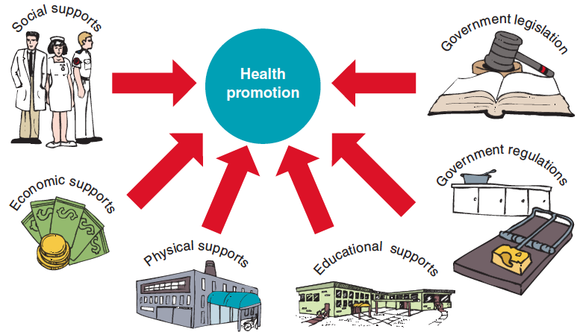
What is health promotion?
4. Economic supports. Governments must allocate sufficient money to support health and welfare programs and enable them to function effectively.
5. Social supports. These include health personnel and community groups who are trained and equipped to assist in health care, such as doctors, nurses, counsellors, support groups and social workers.
6. Educational supports. These include traditional health education programs in schools, as well as information, education and advice provided in other settings; for example, community education via the Quit website
Research has also shown that effective health promotion must involve the community at all levels. People need to feel a part of the system for their behaviours and attitudes to improve.

Slide 60
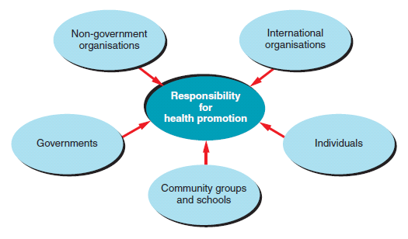
Responsibility for health promotion

Slide 61
Responsibility for health promotion
Group Work
In your groups, read through pages 97-108.
1)What role do they play in health promotion?
2) What specific responsibilities do they have?
3) How do they support health?
Answer the following questions on the butcher’s paper provided
You have 20 mins to complete the task before you present it to the class.

Slide 62
Responsibility for health promotion
Individual Work
Read through and summarise pages 112-113
Health Promoting Schools
Health Promoting Workplaces

Slide 63
OTTAWA CHARTER AS AN EFFECTIVE HEALTH PROMOTION FRAMEWORK
In 1977, WHO recognised a global need for direction in attaining good health for all citizens that would lead them to living socially and economically productive lives by the year 2000. This became known as the global ‘Health for All’ strategy.
To help achieve this goal, a document called ‘The Ottawa Charter’ was developed in 1986 which outlined the five areas of action to achieve good health for all. It is significant as it gave health promotion more direction through clear definitions, action plans and positive involvement. The Ottawa Charter action areas are still regarded as essential to any effective health promotion worldwide. They are based on the understanding that health is socially determined and encourage health professionals and governments not only to educate people about health matters, but also to change the environments in which people live and to involve the community in projects to improve health.
The Ottawa Charter for Health Promotion identified the following prerequisites
for health.
• The basic necessities for health are peace, shelter, education, food, income, a
stable ecosystem, sustainable resources, social justice and equity.
• Health is a positive concept emphasising social and personal resources, as
well as physical capabilities.
• All people should be able to achieve their health potential through the provision
of equal opportunities and resources.

Slide 64

OTTAWA CHARTER AS AN EFFECTIVE HEALTH PROMOTION FRAMEWORK
• All sectors within the community are responsible for health promotion —
health, social and economic sectors, governments, industry, local authorities,
media and voluntary organisations.
In order to achieve these ideals, the Ottawa Charter recognised that there are
five essential actions to improve health and create greater equality in health:
1. developing personal skills
2. creating supportive environments
3. strengthening community actions
4. reorienting health services
5. building healthy public policy.
Homework: Summarise the five action areas of the Ottawa Charter using pages 116-119 in your textbook.

Slide 65
Principles of social justice
Social justice is a value that favours the reduction or elimination of inequality, the promotion of inclusiveness of diversity and the establishment of environments that are supportive of all people.
Equity is the allocation of resources according to the needs of individuals and populations, the goal being to achieve equality of outcomes.
Diversity is variety or difference between individuals and groups of people. It is essential that we are sensitive to people’s differences and adapt programs to meet the needs of the whole population.

Slide 66
SUPPORTIVE ENVIRONMENTS
The social environment in which a person lives or works has a significant influence on that person’s level of health and their ability to be able to make changes to improve their health. Good health is achieved in environments that:
are relatively free of violence, pollution and that have
• a regular supply of safe water and nutritious food
• have an adequate supply of basic necessities such as clothing, shelter and transport
• provide opportunities for recreation and variety in daily living
• cause less stress
• are relatively free of factors that cause isolation and alienation
• have low levels of poverty
• provide safe and interesting work.
Strategies that aim to promote better health need to address the social, cultural, physical and economic factors present in people’s lives in order to create environments that are supportive of health.
In some cases government legislation or policies may be required to bring about changes to environments so they better support good health eg. smoking bans

Slide 67
THE END
Next: Core 2 Body in Motion

