Slide 1
How do Biomechanical Principles Influence Movement?
Motion
Balance and Stability
Fluid Mechanics
Force

Slide 2
Introduction to Biomechanics
Biomechanics is a science concerned with forces and the effect of these forces on and within the human body.
It helps us to understand the use of techniques in different sports and improve the efficiency of movement.
It allows us to choose the best technique to achieve our best performance with consideration to our body shape.
It aids us in the reduction of injury normally associated with poor technique or movements that are not biomechanically sound.
It also influences the design and use of equipment that contributes to improved performance.

Slide 3
Motion
Complete the cloze passage on page 84 of your booklet using the information below:
Motion, or movement is fundamental in sport. Motion occurs as a result of force, the muscular system being the source of force in the human body.
There are two types of motion, linear and angular. Linear motion is movement in a straight line, such a ball rolling along the ground. Angular motion is rotation around an axis, such as a gymnast on the bars. Angular motion occurs at joints, for example flexing the elbow is angular motion. The combination of angular and linear motion is known as general motion. A 100 metre sprint is an example of general motion because the angular motion at the joints combines to cause movement in a straight line.
Momentum is basically a combination of speed and mass. If two athletes weighed the same, but one was travelling faster than the other, the quicker athlete would have more momentum. Similarly, if two athletes were travelling at the same speed, the heavier athlete would have more momentum. Momentum is of particular importance in sports where impacts occur such as AFL, league and union. The outcome of a collision depends largely on the amount of momentum that each body had prior to the impact. The athlete with more momentum would be more difficult to stop in a tackle.
If two athletes collide, the one with the least momentum will suffer a change in momentum or impulse. This can be seen when a small player looks like they have bounced off a larger player, or when a stationary snooker ball is hit by the cue ball.
If force is applied to an object off-centre, then torque is produced. For example, pushing on a bike pedal when it is in front of the axis will result in forward motion, or hitting a ball with topspin or sidespin has the same effect.

Slide 4
Motion
Motion:
Is the movement of a body from one position to another.
Projectile Motion:
Is the movement of an object or body in the air.
Angular Momentum:
Is the tendency of a body or object to continue to spin or rotate.

Slide 5
Motion
Linear Motion:
Takes place when a body and all parts connected to it travel the same distance in the same direction and at the same speed. E.g. A person standing still on a moving escalator or in a lift and a down hill skier have linear motion. The easiest way to determine if a body is experiencing linear motion is to draw a line connecting two parts of the body e.g. The neck and the hips. If the line remains in the same position when the body moves from one position to another, the motion is linear.
In your exercise books, list examples of sports or activities where the athlete is experiencing linear motion.

Slide 6
Motion
Velocity:
Is equal to displacement divided by time.
Velocity = displacement
time
It is used where the object or person does not move in a straight line. E.g. A runner in a cross country race, the flight of a javelin.
Displacement is the movement of as body from one location to another in a particular direction, or an ‘as the crow flies’ measurement.

Slide 7
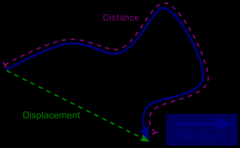
Motion
Five Kilometres (distance)
One Kilometre (displacement)

Slide 8
Motion
Speed:
Is equal to the distance covered, divided by the time taken to cover the distance.
Speed = distance
time
When an object such as a car moves along a road, or a person runs in a race, we often refer to how fast each is moving. This is called speed. If a runner covers a 100m track in 12 seconds, speed is determined by dividing the 100m distance by the time:
100
12 = 8.3 metres per second (m/s)

Slide 9
Motion
Acceleration:
Is the rate at which velocity changes in a given amount of time. This means that an object or a person has the ability to increase speed quickly.
When a person or object is stationary it has zero velocity. An increase in velocity is referred to as positive acceleration, whereas a decrease in velocity is called negative acceleration. E.g. A long jumper would have zero velocity in preparation for a jump. The jumper would experience positive acceleration during the approach and until contact with the pit, when acceleration would be negative.

Slide 10
Motion
Momentum:
Refers to the quantity of motion that a body possesses. It is a product of mass and velocity (mass refers to the amount of matter in a body). Momentum is expressed as:
Momentum = mass x velocity (M = mv)
The application of the principle of momentum is most significant in impact or collision situations. E.g. a truck travelling at 50km per hour collides with a car going at the same speed it would have a devastating effect on the car because the mass of the truck is much greater than that of the car. The car would be taken in the direction that the truck was going. This same principle can be applied to sports such as rugby league and union, where collisions in the form of tackles are part of the game. However, collision between players exhibits different characteristics due to a range of factors such as: the mass difference of the players, elasticity of the human body and the evasive skills of player.

Slide 11
Motion
Complete the questions on pages 85-86 of your work booklets.
Do not worry about the practical activity on page 86, we will complete this later.
Then read through Balance and Stability on page 88 of your work booklet and if you have time, attempt to answer the questions on pages 88-89. For support and extra resources refer to page 223-228 of your text books. (Text books located in computer cupboard)
HAVE A GREAT WEEKEND EVERYONE!!

Slide 12
Balance and Stability
Centre of Gravity:
The centre of gravity of an object is the point at which all the weight is evenly distributed and about which the object is balanced.
In rigid objects such as a cricket ball the centre of gravity is in the centre of the object. This means that the mass is equally distributed around this point; that is, the weight is evenly distributed in all directions.
However, not all objects in sport are spherical or have an evenly distributed mass e.g. A bowling ball or lawn bowls ball. Both have a ‘Bias’ which is a slight redistribution of the mass to one side.
In the human body the position of the centre of gravity depends upon how the body parts are arranged. As the human body is flexible it can assume various positions, altering the location of the centre of gravity. The centre of gravity can even be outside of the human body in various positions.

Slide 13
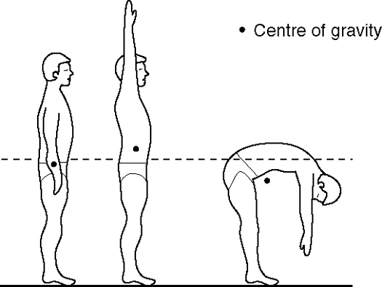
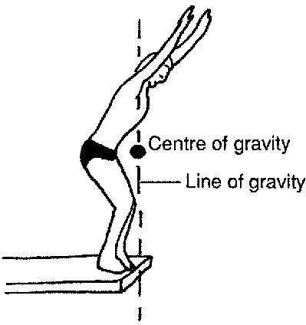
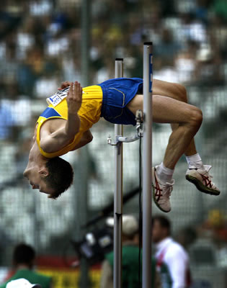
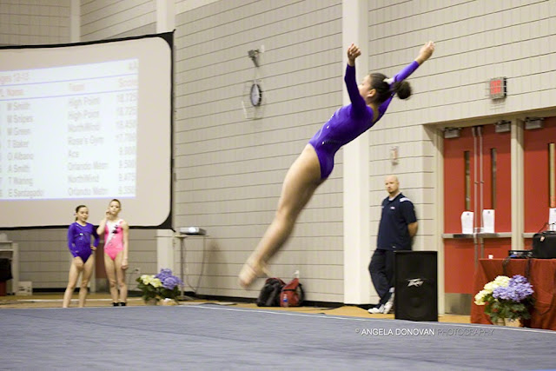
Balance and Stability

Slide 14
Balance and Stability
Varying the centre of gravity in the execution of a skill can enhance performance. High jumpers and long jumpers both lower the centre of gravity in the step or steps immediately preceding take-off. This enables them to propel their body over a slightly longer vertical path than would otherwise be possible.
Please view the media links below:
http://www.youtube.com/watch?v=sPWqimEgXO8
http://www.youtube.com/watch?v=5v9p5jBN_Hg

Slide 15
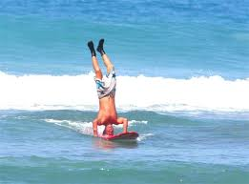
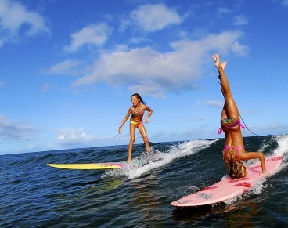
Balance and Stability
Static balance activities such as headstands and handstands require precise manipulation of the centre of gravity. Here, the centre of gravity must be controlled by the base of support, if it moves away from a perpendicular position directly over the base, the person doing a headstand or handstand will fall.

Slide 16
Balance and Stability
Line of Gravity:
The line of gravity is an imaginary vertical line passing through the centre of gravity and extending to the ground.
It indicates the direction that gravity is acting on the body. When standing erect the line of gravity dissects the centre of gravity so that we are perfectly balanced over our base of support.
The closer the line of gravity moves to the outer limits of the base of support, the less stable we become.
Movement occurs when the line of gravity changes relative to the base of support. Movement results in a momentary state of imbalance being created, causing the body to move in the direction of the imbalance.

Slide 17
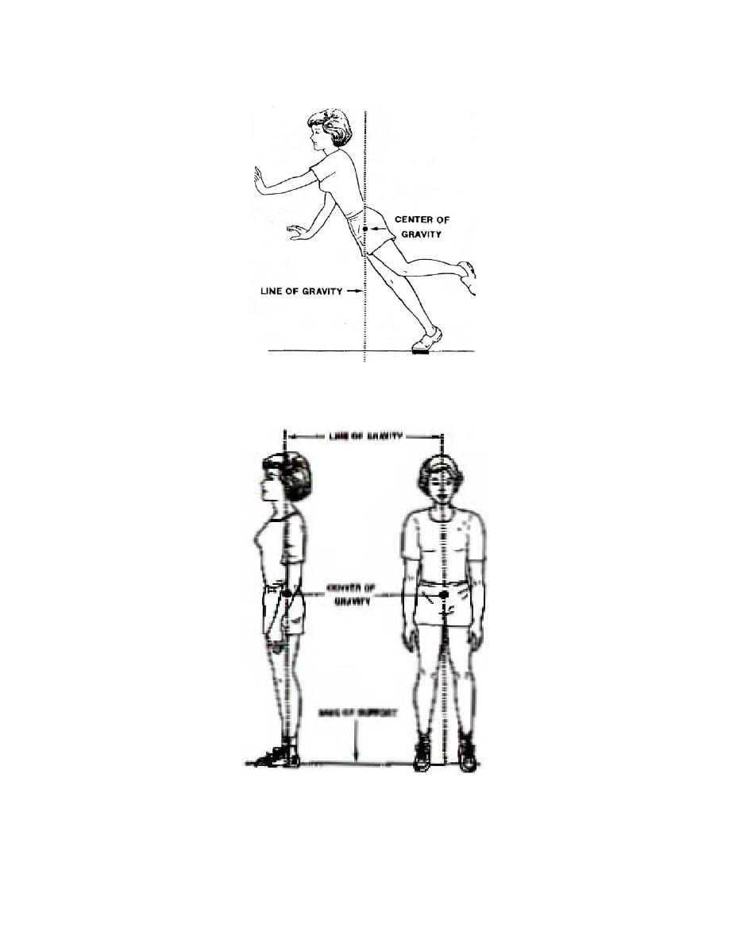
Balance and stability

Slide 18
Balance and stability
Base of Support:
The base of support refers to an imaginary area that surrounds the outside edge of the body when it is in contact with the ground.
A narrow base of support allows the centre of gravity to fall close to the edge of the base of support reducing stability. Additionally the further the centre of gravity from the base, the more unstable is the body or object.

Slide 19
Balance and stability
Complete the activities on pages 88-89 of your yellow booklets.
Then read through the information on Fluid Mechanics on pages 229-232 of your text book (located in the computer cupboard) and attempt the activities on page 90 of your yellow booklet.

